Slide 1
Courage
Performance-Based Task

Slide 2
Part One: Anchor Source
Task: Read the article “Cory Booker’s legend grows: Newark mayor saves woman from fire,” and take notes using the Cornell Note Taking strategy. When reading is complete, answer the text dependent questions, using text evidence to support answers.

Slide 3
Anchor Source: Newspaper Article
Cory Booker's legend grows:
Newark mayor saves woman from fire
By Rene Lynch 4/13/2012 LATimes.com
Cory Booker needs a cape, stat!
The Newark, N.J., mayor -- already lionized in some corners for his good deeds -- added to his list of praiseworthy actions on Thursday night when he raced into a burning home to help save a woman trapped inside. The woman, who suffered second-degree burns on her neck and back, is reported to be in stable condition. Booker got away with only minor burns and smoke inhalation.
And, of course, his heroics exploded into a national story overnight.
At one point Friday morning, "Cory Booker" was the most-searched term on Google this morning as the public tries to learn the details of Booker's heroics. NPR has crowned him "today's hero." And over on Twitter, the story has taken on a humorous life of its own, with social media types trying to outdo themselves with made-up #corybookerstories. (Example: "When Chuck Norris has nightmares, Cory Booker turns on the light & sits with him until he falls back asleep.")
A rising star in the Democratic Party, Booker, 42, is considered a possible gubernatorial candidate in next year's race. The elected leader of New Jersey's largest city -- one that battles chronic problems such as crime, drugs and violence -- Booker has been praised for actions that have had a way of grabbing the limelight.
After his election, instead of living in posh, mayorly quarters, he continued to live in one of the most impoverished neighborhoods in the city to better stay connected with the people. During a 2010 blizzard that paralyzed the city, Booker grabbed a shovel and got to work. And when late-night talk show host Conan O'Brien began taking potshots at Newark, Booker turned the joke back on O'Brien, banning him from using Newark Liberty International Airport and demanding a public apology. The running "feud" ended when Booker made an appearance on the show to patch things up.
Continued on next slide

Slide 4
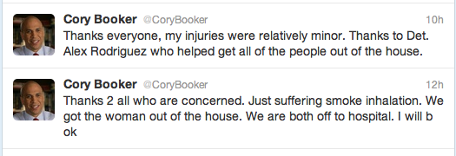
A Rhodes scholar with degrees from Yale, Stanford and Oxford, the social media-savvy Booker has also been interviewed by Oprah, who wanted to know all about his unorthodox approach to caring for his constituents.
His latest actions shouldn't hurt his political aspirations (unless someone accuses him of taking a job away from a firefighter).
Booker was returning home Thursday night when he saw his neighbor's home ablaze, he told "CBS This Morning." A shrieking woman said her daughter was still inside.
Firefighters had been called but had not yet arrived. The mayor's security detail tried to drag him away, but Booker feared that the young woman might die, Det. Alex Rodriguez told CBS. “Without thinking twice, he ran into the flames and rescued this young lady,” said Rodriguez, who was there and helped in the rescue.
Booker acknowledged he was scared. He ventured inside just as the kitchen erupted into flames and he couldn't immediately find the woman. Then she called for help, and Booker found her in a bed. The 6-foot-3 Booker threw her over his shoulder and ran for the exit.
“I punched through the kitchen and the flames and that's when I saw Det. Rodriguez. He grabbed her as well and we got her down the stairs and we both just collapsed outside,” Booker said.
“Honestly it was terrifying and to look back and see nothing but flames and to look in front of you and see nothing but blackness,” Booker said, adding that the incident gave him even more respect for the work of firefighters. He called the incident a “come-to-Jesus moment.”
Booker was treated for smoke inhalation and minor, second-degree burns, and his thumb and a finger on his right hand had to be bandaged. It wasn't enough to keep the mayor from tweeting, however.
“Thanks 2 all who are concerned. Just suffering smoke inhalation,” Booker signaled to his followers shortly after the incident. “We got the woman out of the house. We are both off to hospital. I will b ok.”
Early Friday, he added: "Thanks everyone, my injuries were relatively minor. Thanks to Det. Alex Rodriguez who helped get all of the people out of the house.”
The cause of the fire was unknown.
The Associated Press contributed to this report.
Tweets from Cory Booker soon after the incident

Slide 5
Cornell Notes
Step 1: Notes
Take notes on the text and gather facts about the topic.
Step 2: Questions
Anticipate Quiz questions that would prompt the notes you took.
Step 3: Summary
Write a summary of the text.

Slide 6
Part Two: Additional Sources
Directions: Read the essay prompt on the next slide. Then, read and analyze all of the additional texts by taking notes. In addition to the anchor source, you must include at least two support texts in your essay.

Slide 7
Performance-Based Argument Task
Prompt: You are preparing to debate a team from another school and have been given the following argument to defend or refute:
It takes a certain kind of person to show courage. In other words, only people who are smart, strong, and privileged are courageous. Make sure your argument is central; use evidence from the anchor text and three of the supporting sources to support your reasoning. Avoid merely summarizing the sources. Indicate clearly from which sources you are drawing, whether through direct quotation, paraphrase or summary.

Slide 8
Support Source #2: Video
Directions: View “Dr. Martin Luther King - Profile in Courage” and take notes on Dr. King’s courageous traits.

Slide 9
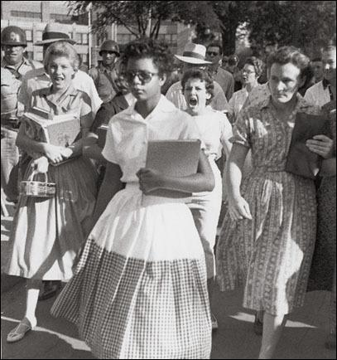
Support Source #4: Photograph
Directions: Students will view Hazel Bryant Photo - 100 photos that changed the world by TIME. A good strategy for critically “reading” pictures and art for its message is to teach students to observe the following: setting, size of object, color, light, angle, direction objects are facing, body language and clothing. Students should be encouraged to take notes on the picture for use in their essay.

Slide 10
PBT Checklist:
When constructing your essay, be sure to
refer to the anchor source in your essay.
use at least two other sources to support your essay.
properly cite each reference used within your essay.
organize your essay in a logical structure that is easy to follow.
Include an introduction and a conclusion.
Share your document with me when you are finished.
Name it X_PBT_CoA_Essay_YourName
X is your period number

